Slide 1
Memory Systems Design
  Introduction: 2 Lectures
    Classification of Memory Technology
    Expanding Memory Width and Size
    Memory and CPU Interfacing
  Address Decoding: 3 Lectures
    Full Address Decoding Techniques
    Partial Address Decoding Techniques
    Block Address Decoding Techniques
©Paul Davies. Not to be copied, used, or revised without explicit written permission from the copyright owner.
This lecture may contain animations and is best viewed as a slide show

Slide 2
Original Motorola 68000: A Typical 16-bit data bus Interface:
Address Bus – Address limit is 8M words. 2²³). Issued by CPU whenever it wishes to access any individual memory/IO location within 8M word space. Note there is no A₀
A₁ – A₂₃
‘23’ bit Wide Address Bus
Data Bus – Each memory location is 16 bits wide, thus total addressable storage is 16M bytes. Most 16/32 bit CISC CPUs have the ability to address either a long word, word or a byte at a time using some combination of signals such as LWORD, UDS and LDS etc. signals
D₀ – D₁₅
‘16’ bit wide Data Bus
32 bit Internal Address Space
D₀ – D₃₁
AS
Address Strobe: Logic 0 when an address is Valid
R/W
Read/Write: Logic 0 for a write operation, 1 for a read
68000
BERR
Bus Error: Timeout input from non-responding memory
UDS
Upper and Lower Data Strobes that replace an A₀
Used to access individual bytes, within a 16 bit word
LDS
DTACK
Data Transfer Acknowledge: A handshake back from the memory system saying data has been transferred.
http://experts.about.com/e/m/mo/Motorola_68000.htm
68000 uses Asynchronous data transfers. This means the CPU issues an address and the memory system must supply an acknowledge (via the DTACK signal) back to the CPU to complete the access, otherwise the CPU will enter wait states. This means CPU can adjust its speed to that of the device it is accessing at the time. BERR can be issued when the CPU attempts to access memory that does not exist and therefore will not produce a DTACK. Transfers would then be abandoned. BERR was used to implement paging in Unix type OS’s with a H/W memory management unit (MMU)

Slide 3
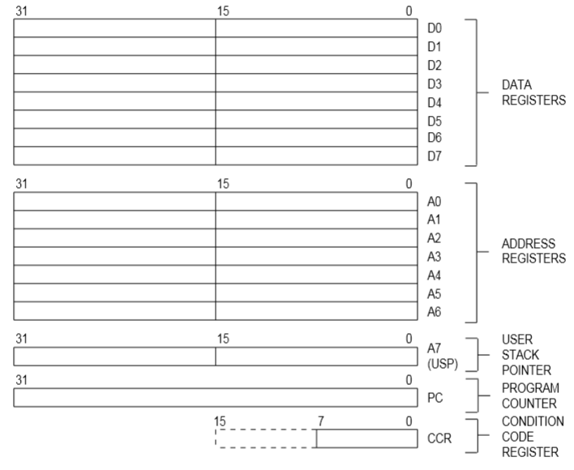
68000 Programmers Model (Internal Registers)
8
Notes:
68000 has eight 32 bit data registers (accumulators) that can be treated/manipulated as either
Byte wide: Meaning only the lower 8 bits are involved in the operation (instruction used a “.b” modifier)
Word wide: Only the lower 16 bits are involved (the default but instruction could be written with a “.w” modifier)
Long Word: All 32 bits are involved (instruction used a “.l” modifier)
Example
add.b #1, d0 add ‘1’ to the lower 8 bits of d0 (remaining bits in d0 unaffected)
sub.w d1, d0 subtract the lower 16 bit value in d1 from the lower 16 bit value in d0 and save the result in the lower 16 bits of d0
and.l d3, d5 bit wise ‘and’ all 32 bits of d3 with d5 and save 32 bit result in d5
68000 also had eight 32 bit address registers (a compiler would implement C style pointers using these address registers).
lea.l #$ffc00000,a0 load the 32 bit hex address value FFC00000 into a0
move.w (a0), d0 move a 16 bit value into d0 from the address specified or held in a0
move.b (a0)+, (a1)+ move a byte from the address held in a0, to the location whose address is held in a1, then increment both a0 and a1 by the size of the data moved (1 because it was a byte). Useful for string copying etc.
A7 was reserved for use as the stack pointer. 68k had two stack pointers, one for the user mode (i.e. your programs) and the other for use by the OS
The Condition code register held all those useful bits such as Carry, Zero, Overflow etc and was updated after each instruction and could be used with conditional branch instruction e.g. BEQ (branch if equal – i.e. Zero flag is set)
The upper 8 bits of the CCR (correctly referred to as the Status register) contained the status of the 68k (1 bit to indicate if running in supervisor mode or in user mode). It also contained 3 bits to set the level of interrupts recognised by the chip externally
For more details on programming in assembly language (not important for this course as we shall be using ‘C’ throughout), visit (https://en.wikipedia.org/wiki/Motorola_68000)

Slide 4
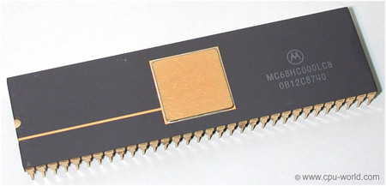
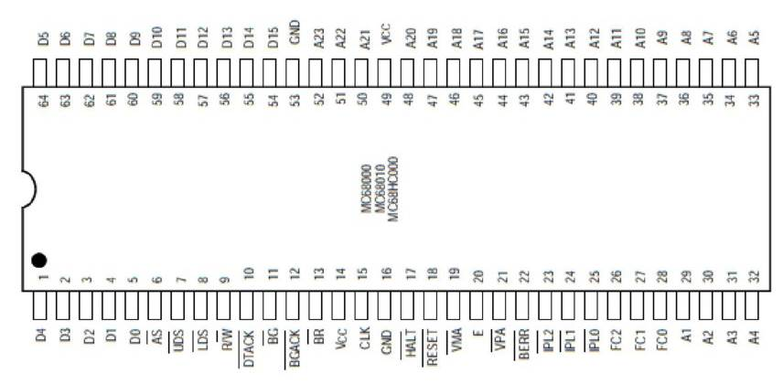
Motorola 68000 Address Bus
The original 68000 was limited to a 23 bit external address bus, even though internally its address bus was 32 bits. In fact there was not even an A0 signal.
This restriction allowed the processor to fit inside a 64 pin DIP (dual in-line package) which was a common (if large) format at the time.
The result of this is that the internal address bits A31-A24 of any address issued by a program got discarded during a memory access.
The following instruction, which wrote the lowest byte of d0 to location FF000400
move.b d0, $FF000400
  resulted in a byte actually being written to location/address $0000 0400

Slide 5
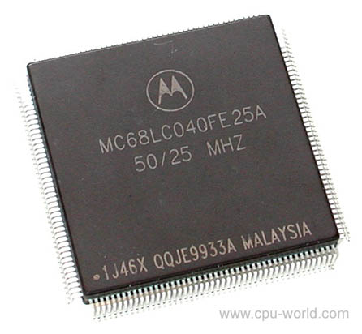
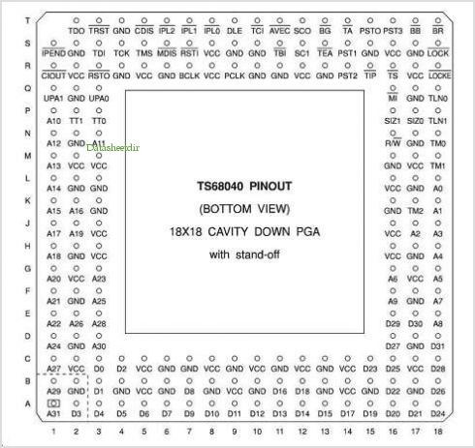
Motorola 68000 Address Bus
There is no reason why A0 could not have existed (except to fit in the 64 pin package), as it can be created from UDS, i.e. A0 = UDS (provided a byte transfer is under way, A0 is meaningless for a word transfer since a word is two bytes).
Subsequent 68000 family processors such as the 68020/30/40/60 all had an A0 address line and also had address lines A31-24, but they used Ball Grid Array or PLCC packaging rather than DIP, thus they could have more pins.
The soft core 68k processor used in CPEN 412 does not need to constrain itself to a 64 pin package, consequently it has the full complement of address lines A31-A0 and can thus address 4Gbytes of memory (2³²). Although we still only use A31-A1

Slide 6
Next Slide Very
Important from a
Software/Hardware
Perspective

Slide 7
Motorola 68000: The LDS*/UDS* signals
Because 68k has no ‘A0’ (only A1 to A23), the 68000 address bus carries the address of a 16 bit ‘word’ where the data is located. If LDS and UDS are both active, then a 16 bit word of data is transferred over (D0-D15). When LDS alone is active, a single byte is transferred on D0-D7, and when UDS alone is active a single byte is transferred on D8-D15.
Note: Every byte in memory has its own unique address. The 68000 issues a word address (i.e. the address of 2 bytes) and uses UDS* and LDS* to access either or both bytes.
Upper Byte: Bits D8 – D15
UDS* = 0
Lower Byte: Bits D0 – D7
LDS* = 0
Address (a23-a1)
Word Address 7F FFFF
Byte Address FF FFFE
Byte Address FF FFFF
Address FF FFFE
Address FF FFFF
Word Address 7F FFFE
Byte Address FF FFFC
Byte Address FF FFFD
Address FF FFFC
Address FF FFFD
Word Address 7F FFFD
Byte Address FF FFFA
Byte Address FF FFFB
Address FF FFFA
Address FF FFFB
Word Address 7F FFFC
Byte Address FF FFF8
Byte Address FF FFF9
Address FF FFF8
Address FF FFF9
Even Byte Address
Odd Byte Address
Word Address 00 0003
Byte Address 00 0006
Byte Address 00 0007
Address 00 0006
Address 00 0007
Word Address 00 0002
Byte Address 00 0004
Byte Address 00 0005
Address 00 0004
Address 00 0005
Word Address 00 0001
Byte Address 00 0002
Byte Address 00 0003
Address 00 0002
Address 00 0003
Word Address 00 0000
Byte Address 00 0000
Byte Address 00 0001
Address 00 0000
Address 00 0001
68000 is a BIG ENDIAN processor as it stores bits 8-15 of a word at the lower byte address (i.e. the big end of a 16 bit value is read/written first) (see
http://en.wikipedia.org/wiki/Endianness) Intel Processors are LITTLE ENDIAN
IMPORTANT : Accesses to a 16/32 bit word/long word must be ALIGNED, i.e. use an even addresses when asserting LDS* and UDS* simultaneously – Think about why.

Slide 8
Example 68000 Data Transfers
What data bus lines carry the data in the following assembly language instructions and what values appear on the 23 bit Address and Data buses , and the R/W*, UDS* and LDS* signals during the transfer? Describe the operation in detail.
  move.b d0,$0 move a byte from register d0 to address 0
  move.b d0,$1 move a byte from register d0 to address 1
  move.b d0,$2 move a byte from register d0 to address 2
  move.b d0,$FF move a byte from register d0 to address hex FF
  move.w d0,$0 move a 16 bit word from register d0 to address 0
  move.w d0,$2 move a 16 bit word from register d0 to address 2
  move.w d0,$3 move a 16 bit word from register d0 to address 3
  move.l d0,$0 move all 32 bits of register d0 to address 0
  move.l d0,$1 move all 32 bits of register d0 to address 1
  move.b $0,$2 move a byte from address 0 to address 2
  move.w $0,$2 move a 16 bit word from address 0 to address 2
  move.w $0,$1 move a 16 bit word from address 0 to address 2
  move.l $0,$4 move a 32 bit word from address 0 to address 4

Slide 9
Motorola 68000 Data Transfers
Solutions
  move.b d0,$0 write lower 8 bits of d0 to word address 0: D15-D8 and UDS*
  move.b d0,$1 write lower 8 bits of d0 to word address 0: D7-D0 and LDS*
  move.b d0,$2 write lower 8 bits of d0 to word address 1: D15-D8 and UDS*
  move.b d0,$FF write lower 8 bits of d0 to word address 7F: D0-D7 and LDS*
  move.w d0,$0 write lower 16 bits of d0 to word address 0: D15-D0, LDS* & UDS*
  move.w d0,$2 write lower 16 bits of d0 to word address 1: D15-D0, LDS* & UDS*
  move.w d0,$3 ILLEGAL word operations can only be done to even addresses
  move.l d0,$0 write upper 16 bits of d0 to word address 0 then write lower
  16 bits to word address 1: D15-D0, LDS* & UDS*
  move.l d0,$1 ILLEGAL 32 bit operations can only be done on even addresses
  move.b $0,$2 read a byte from word address 0, write to word address 1
  move.w $0,$2 read a word from word address 0, write to word address 1
  move.w $0,$1 ILLEGAL, word write to ODD address is not allowed
  move.l $0,$4 move a 32 bit word from address 0 to address 4. This involves 2
  word reads, followed by two words writes

Slide 10
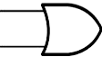
A typical 256k word (512K byte) memory block based on 256Kbyte devices
DTACK
Chip selects are derived from an Address Decoder circuit which is a function of the unused address lines of the CPU address bus (A19-A23 here) (See next lecture) and is used to activate the memory for a sub-range of CPU addresses
BERR
Address
Decoder
&
Dtack
Generator
Address
Decoder
CS
OE may be connected to CS or ground in a simple system.
A19-A23
R/W
OE
OE
WE
WE
What is the address range of this 16 bit wide block of memory?
LDS
CS
UDS
CS
256k x 8
256k x 8
D0-D7
D0 - D7
D8-D15
D0 - D7
A0 - A17
A0 - A17
A1-A18
A1 – 18 on CPU connected to A0 - A17 on Memory chip.
68000 requires 16 bit wide memory, which means we don’t use A0. Instead we use A1 – A18 address which = 2¹⁸ or 256k locations, each of which is 16 bits or 2 bytes
Important: 68000 memory must always be designed to be 16 bit wide, accessible as independent bytes

Slide 11
Calculating the Address Range of a Memory Block
What is the address range of the previous 16 bit wide block of memory?
The memory utilises 18 address lines (A1 – A18) and uses a 16 bit wide data bus
2¹⁸ means 256k words or 512k bytes of memory.
We can’t see what is happening inside the address decoder so we do not know what the first or base address of the memory is, but we do know that it extends for 512k bytes beyond that base address.
If we take the 18 address lines of the memory chip (labelled A17..A0) in isolation, we can write them out in binary, so the first location is (Base + 0)
A17…………………………….…….A0
00 0000 0000 0000 000 0 first location (Base + 0)
11 1111 1111 1111 1111 last location (Base + 3FFFF)
By substituting 0’s for the address lines, we get the first location relative to the base address defined by the external address decoder (not shown in previous slide)
By substituting 1’s for the address lines, we get the address of the last location relative to the base address.

Slide 12
Original 68000 Memory Organization
Reserved Memory Space and Memory Maps
All CPUs reserve memory space for special boot vectors and BIOS code to bring the system to life.
For 68k, locations 00 0000 to 00 03FF are reserved for a Vector Table containing interrupt, reset and other exception vectors. The designer may use the remaining space for anything else.
Usually the space immediately above the vector table is occupied by boot code. By placing vector table and boot code back to back they can be stored in the same ROM chips so that the table and boot code are always there to bring the system to life after a reset or on power up.
The rest of the memory address space up to
$FFFFFF is for general purpose use e.g. memory and memory mapped IO devices.
In small systems it is common for the general purpose memory area to be only partly populated with actual memory chips, thus there may be large unused gaps in the address space.
FF FFFF₁₆
General
Purpose
Memory Area for
Memory and
Peripherals
General
Purpose
Memory Area
00 4000₁₆
00 3FFF₁₆
Boot code
such as a
Debug Monitor
or OS boot Code
e.g. 16k
Boot code
such as a
Debug Monitor
e.g. 16k
00 0400₁₆
00 03FF₁₆
Exception
Vector Table
Exception
Vector Table
00 0000₁₆

Slide 13
A Typical 32-bit RISC CPU Interface: LPC2294 ARM Core from Phillips
Address Bus – External Address limit is 16Mbytes (i.e. 2²⁴). Note A₀ and A₁ may not get used depending upon chosen data bus width (programmable within chip).
A₀ – A₂₃
‘24’ bit Wide Address Bus
Data Bus – Each location is UP TO 32 bits wide, but may be configured to be 8, 16 or 32 bits, (Programmable within chip). Access to bytes is via BLS signals below
D₀ – D₃₁
‘32’ bit wide Data Bus
32 bit internal Address Space
D₀ – D₃₁
Byte Lane Select signals – Used to select individual Bytes during a memory access. 32 bit memory interfaces use all 4 signals, 16 bit wide memory interfaces use BLS0/BLS1 and 8 bit wide memory interfaces use BLS0 only. Similar concept to LDS*/UDS* on the 68000
BLS0
BLS1
BLS2
BLS3
LPC2294
Arm 7 Core
WE
OE
CS0
4 chip select outputs to allow the creation of 4 external banks/blocks of up to 16Mbytes each. The signals are internally decoded from the 32 bit Address space of the CPU core and are asserted when a valid address is present. Addresses range for each CS* are programmable.
CS1
CS2
CS3
Philips LPC2294 is a specialist 32 bit RISC microcontroller based on ARM7 core with on chip memory, CANBUS, I²C bus, A/D conversion, timers/counters. External Memory interface (shown above) is synchronous and EVERYTHING about it is programmable from width, address Map to speed. Four chip select signals give access to 4 banks of 16MBytes. Being a RISC based processor, all program accesses involve 32 bit transfers, i.e. individual access to bytes or words is not permitted (unlike 68000)

Slide 14
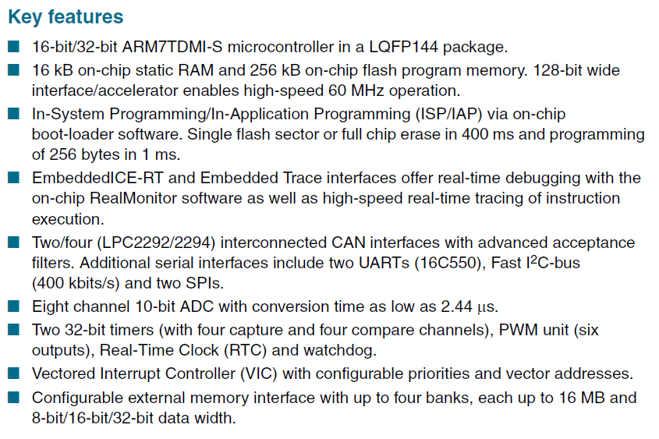
LPC2294 – 60MHz ARM Microcontroller from Phillips

Slide 15
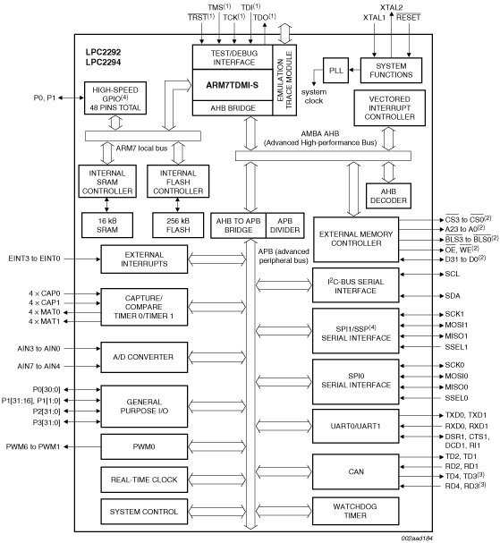
LPC2294 – 60MHz ARM Core from Phillips
Programmable
External Memory
Interface: Rom, Ram, Flash etc, but not Dram

Slide 16
Typical 256k x 32bit (1M Byte) Memory Bank for LPC2294
CS typically refers to 1 of the 4 CS signals issued by LPC2294 giving a 16MByte address space but may be further decoded from unused address lines for smaller blocks of memory such as this
OE, WE and the BLS signals come directly from LPC2294
CS
OE
WE
OE
OE
OE
OE
WE
WE
WE
WE
BLS0
CS
BLS1
CS
BLS2
CS
BLS3
CS
256k x 8
256k x 8
256k x 8
256k x 8
D0-D7
D0-D7
D8-D15
D0-D7
D16-D23
D0-D7
D24-D31
D0-D7
A0-A17
A0-A17
A0-A17
A0-A17
A2-A19
18 address lines = 256k x 32bits
LPC2294 does not use A0,A1 when interfacing to 32 bit wide memory systems
32 bit data can be accessed in one operation
32 Bit Memory Interface using byte wide memory chips

Slide 17
Typical 512k x 16 bit (1M Byte) Memory Bank for LPC2294
CS
OE
WE
OE
OE
WE
WE
BLS0
CS
BLS1
CS
512k x 8
512k x 8
19 address lines = 512K locations of 16 bits
D0-D7
D0-D7
D8-D15
D0-D7
A0-A18
A0-A18
A1-A19
LPC2294 does not use A0 when interfacing to a 16 bit wide memory system.
32 bit data access needs two memory accesses and two separate word addresses
16 Bit Memory Interface using byte wide memory chips.

Slide 18
Typical 1M x 8bit Memory Bank for LPC2294
CS
OE
WE
OE
WE
BLS0
CS
1M x 8
D0-D7
D0-D7
20 addr lines = 1Mbyte
A0-A19
A0-A19
LPC2294 uses all Address lines with an 8 bit memory system interface
32 bit data needs four memory accesses and four separate byte addresses
8 Bit Memory Interface using byte wide memory chips.

Slide 19
Generic Memory Schemes: Example 68000
Lower Address Bits depending on memory size
CS0
Memory Block 1
68000
Address Decoder
Logic
A₁ – A₂₃
‘23’ bit Wide Address Bus ²
CS1
AS
AS indicates valid address
Memory Block 2
BERR
BERR indicates invalid address ¹
DTACK
DTACK indicates memory has responded
CS2
Memory Block 3
Address Decoder produces DTACK or BERR at correct time depending upon address
CSN
Memory Block N
Chip Select Signals for each block based on CPU address
D₀ – D₁₅
‘16’ bit wide Data Bus
UDS
UDS indicates valid data on D8-D15
LDS
LDS indicates valid data on D0-D7
R/W
¹ not present on soft core 68000 used in CPEN 412
² soft core 68000 used in CPEN 412 has A31-A0

Slide 20
Dynamic Bus Sizing
Some processors support Dynamic Bus Sizing. Here the CPU will adjust it’s data transfers to match the width of the memory actually being accessed. Usually this happens when the CPUs native data bus is wider than the actual memory data bus (but can work the other way around too). The most common reason is to allow designs with lower cost memory e.g. using one 16 bit memory chip, instead of the 2 required to create a 32 bit memory interface.
To some extent the 68000 does this already when reading a 32 bit operand from a 16 bit wide memory – that is, it automatically generates 2 back to back 16 bit transfers, but the 68k always knew that a 32 bit transfer needed two 16 bit transfers, since it only has a 16 bit wide data bus.
With real dynamic bus sizing, the processor does not assume the width of the memory it is accessing or the number of bus cycles required. It outputs the address and a request for the size of data it wants to transfer and waits for the memory at that address to inform it of its data bus width. The processor then generates whatever number of bus cycles are required to complete the transfer.
Using such a scheme, Prom and simple IO devices might be based on a 8 bit wide data bus (for cost), SRam on 16 bit and DRam on 32 bits (for performance) giving enormous flexibility.

Slide 21
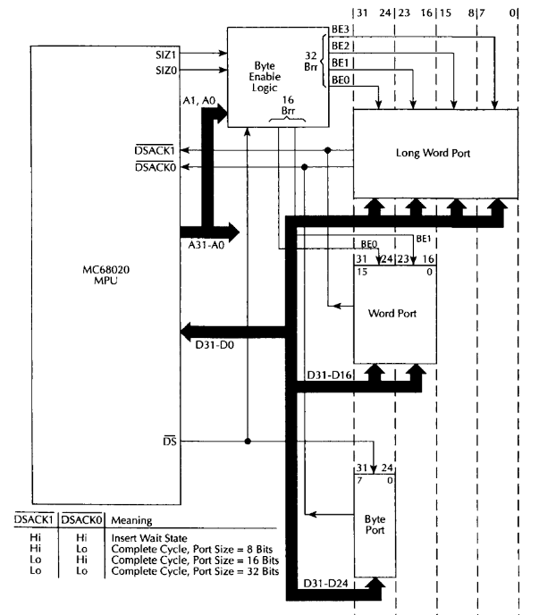
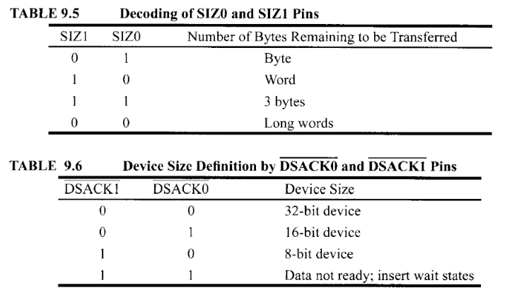
Dynamic Bus Sizing
You design this logic
The 68020 supported dynamic bus sizing with a 32 bit wide data bus.
Processor specifies the size of the transfer it wants using SIZ0-SIZ1
Memory responds with its width using DSACK0-DSACK1.
68020 transferred data over upper ‘n’ bits (n = width of port) of data bus and generated # of cycles required.
System could be based around
8, 16 or 32 bit memory for best cost/performance tradeoffs
You design Byte enable Logic + memory width and generate DSACK’s.
Notes:
Dynamic bus sizing means the host CPU (in this example a 68020) can automatically adjust its memory accesses to transfer data over any width of data bus, that is, it automatically adjusts the size of its data bus to be compatible with whatever memory or IO device it is talking with. As an example, if you wrote code to write 32 bits of data to a 16 bit wide memory device, the 68020 would automatically split the 32 bit data into two 16 bits chunks and perform two back-to-back 16 bit writes to successive location. This would obviously be slower than a single 32 bit transfer, but it means cheaper memory chips can be used (2 rather than 4 byte wide devices). Similarly a 32 bit read from an 8 bit wide memory would result in 4 back-to-back byte reads. This how the LPC2294 ARM core on pages 16-18 can be interfaced to 32/16/8 bit memory without alterations to the program code
In the case of the 68020, it tells the memory what width of data it is trying to read/write, and the memory responds by telling the CPU what data width it can support the 68020 adjusts automatucally.

Slide 22
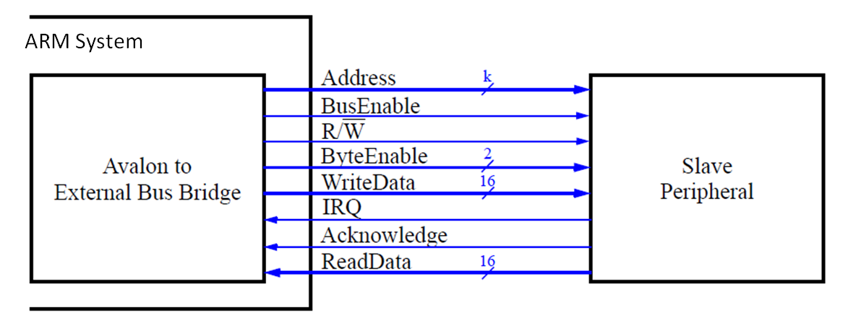
Dynamic Bus Sizing – Altera Avalon FPGA Bus
Altera’s Avalon FPGA bus supports (external to the CPU) dynamic Bus sizing via bridges (as do many FPGA buses). Avalon standard supports:-
  Wider Master to Narrower Slave, e.g. 32 bit processor to 16 bit slave device e.g. ARM or NIOS to 16 or 8 bit Memory or IO device.
  Narrow Master to Wider Slave e.g. 32 bit processor to 64 bit memory.
Illustration below shows a 32 bit master to 16 bit slave with 2 byte enable lines. Interface between processor and slave generated with tools (Platform Designer).
Includes a built in state machine to generate necessary bus cycles.
32 bit ARM or NIOS CPU
Bridge contains a state machine that generates multiple bus cycles to transfer data to/from slave.
16 bit Slave (Memory or Peripheral)

Slide 23
Dynamic Bus Sizing – Altera Avalon FPGA Bus
From a system-level perspective, dynamic bus sizing offers three benefits:
  32/64 bit processors can use inexpensive 16-bit wide memory for data and instruction storage. Without dynamic bus sizing, it would be impossible for a processor to execute code from memory that is narrower than the instruction width. However a 32 bit fetch would take two bus cycles from a 16 bit memory.
  The physical width of memory is hidden to the software.
  Software takes fewer instructions and executes faster, because software doesn’t have to perform any read/write and shift type operations to patch together units of data from say a narrower bus.
  e.g. a 32 bit CPU can just read or write 32 bit data to an 8 bit memory or peripheral device and leave the dynamic bus sizing logic to split that into 4 separate read/write transfers.

Slide 24
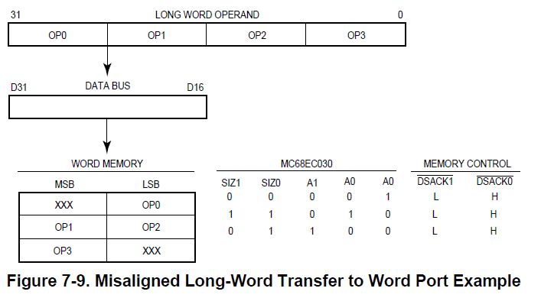
Misaligned/Unaligned Data Transfers
Closely related to Dynamic Bus Sizing is Misaligned/Unaligned data transfers.
The 68000 had fixed rules related to 16 & 32 bit transfers - They had to be aligned i.e. occur at “even” addresses so that they did not straddle a 16 bit “word” boundary. If you tried to transfer 16 or 32 bit data at an “odd” address, an exception occurred.
Some processors e.g. Pentium (and 68030) do not have this restriction. The illustration below shows how a long-word (32 bit) operand would be transferred to an odd address via a 16 bit wide interface. This required 3 bus cycles. Yes it’s slower, but it helped with memory usage and flexibility, (but complicates cache fills).
Altera’s Avalon bus does not support unaligned transfers, but ARM’s AXI bus does. https://community.arm.com/developer/ip-products/system/f/soc-design-forum/43620/aligned-and-unaligned-word-transfers-on-a-64-bit-bus
32 bit write to odd address e.g. 001
“Big Endian” Transfer (OP0/1 first) over 16 bit wide port using D31-D16
Attempted Memory Actual Odd/Even Addr
32 bits 16 bit 8 bit Odd
24 bits 16 bit 16 bit Even
8 bit 16 bit 8 bit Odd
Even Byte (D15-8)
Odd Byte (D7-0)

